Slide 1

MoaYo
고리고리
Copyright ⓒ Slug. All right reserved.

Slide 2
목차
01
02
CONTENTS
Precondition
What is MoaYo?
03
04
Function of MoaYo
QnA
Copyright ⓒ Slug. All right reserved.

Slide 3
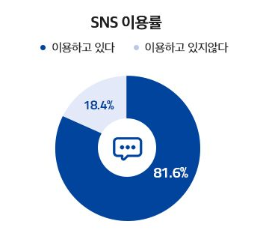
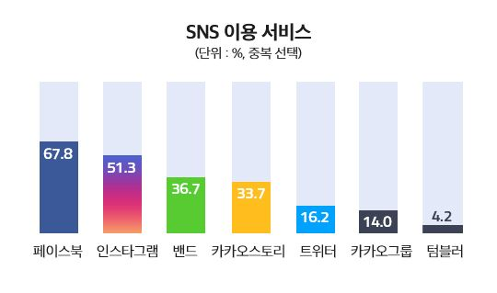
01
Utilization Status of SNS
Copyright ⓒ Slug. All right reserved.

Slide 4
01
Function of Instagram
Copyright ⓒ Slug. All right reserved.

Slide 5
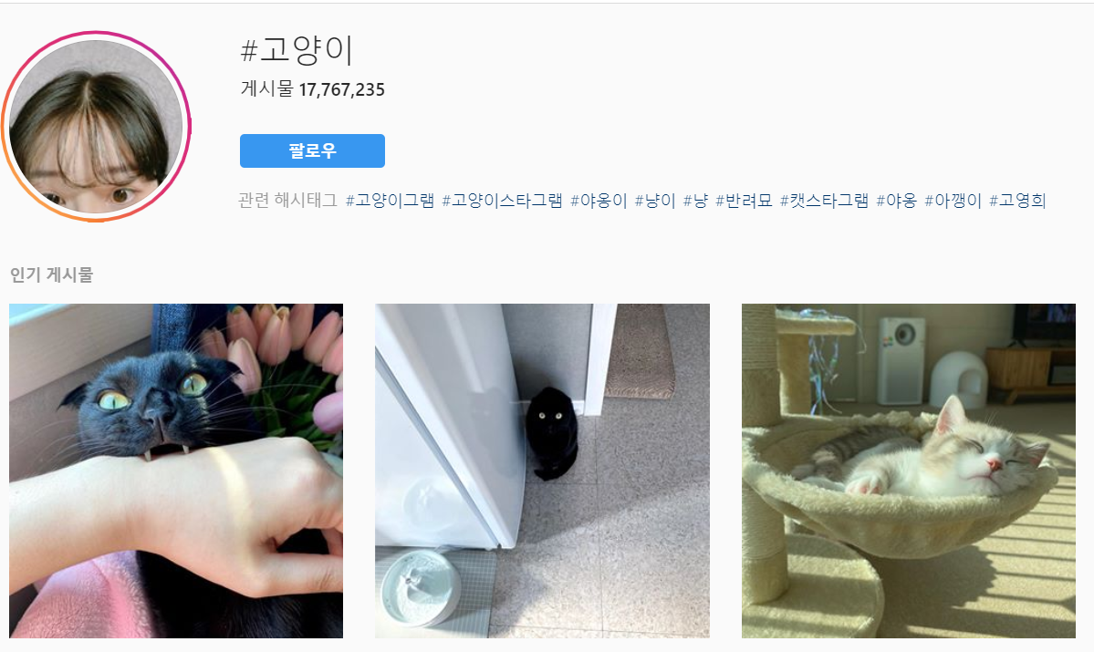
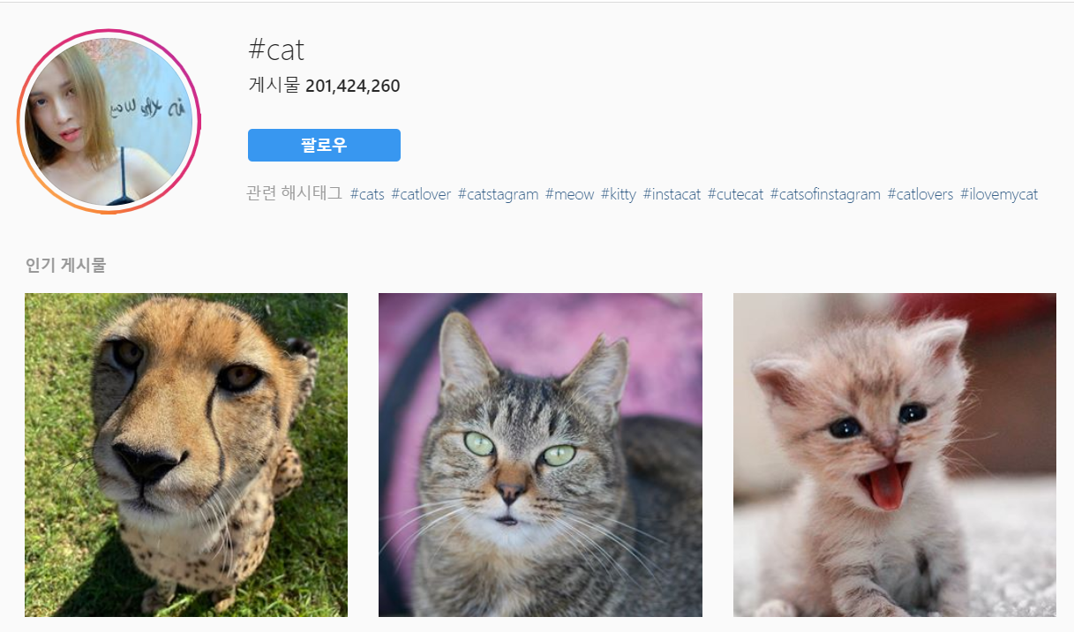
IDOL
BOYGROUP
GIRLGROUP
EXO
BTS
REDVELVET
TWICE
01
≠
Can’t hierarchy!
Search tag
Click content
sharing
Same mean! Different result!
Limit of Instagram
Can’t Once!
Copyright ⓒ Slug. All right reserved.

Slide 6
02
MoaYo
내 손안의 카테고리
인스타그램을 사용하는 사용자들이 게시물들을 저장, 관리함에 있어 계층(Hierarchy)구조를 제공하고, 이렇게 카테고리로 분류된 게시물들을 한번에 공유할 수 있는 앱 서비스
What is MoaYo?
Copyright ⓒ Slug. All right reserved.

Slide 7
02
Architecture of MoaYo
Copyright ⓒ Slug. All right reserved.

Slide 8
EXO
BTS
REDVELVET
TWICE
IDOL
BOYGROUP
GIRLGROUP
EXO
BTS
REDVELVET
TWICE
03
Can Hierarchy!
Search tag
Select content
sharing
Search Category
Select Content
Share
Can Once!
Function of MoaYo
gatto
Cat
С
Katze
고양이
Gato
고양이
बिल्ली
ネコ
Chat
kucing
猫
mèo
เจ้าเหมียว
Same mean, Same Result!
Copyright ⓒ Slug. All right reserved.

Slide 9

질의응답
Question & Answer
Copyright ⓒ Slug. All right reserved.

Slide 10
감사합니다
고리고리
Copyright ⓒ Slug. All right reserved.

